Slide 1
DATA ANALYSIS
PRIYANKA B,
Senior Associate Mentor,
Consensus Academy.

Slide 2
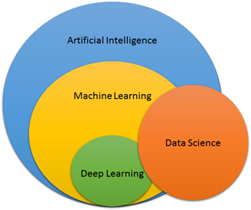
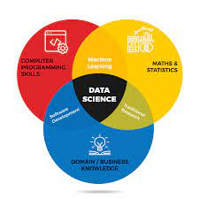
Introduction
The process of exploring and analyzing large datasets
to make predictions and boost data-driven
decision making.
It allows us to collect, clean, and
transform data to derive meaningful insights.
It helps to answer questions, test hypotheses, or
disprove theories.
Notes:
What is data science → based on historic and present data, we could visualize and predict the future with new output
Why do we need data science → to improve quality, production in business, healthcare, stock market,....
Data Analytics - To analyse and predict and interpret on what has happened and it is the subset/branch of data Science
Data Analytics Process Steps - Five steps involved in the data analytics process:
Data Collection: To collect or gather relevant data from multiple sources such as different databases, web servers, log files, social media, excel and CSV files, etc.
Data Preparation: To prepare the data involves cleaning the data to remove unwanted and redundant values, converting it into the right format, and making it ready for analysis.
Data Exploration: To use various data visualization techniques to find unseen trends from the data.
Data Modeling: To build your predictive models using machine learning algorithms to make future predictions.
Result interpretation: To derive meaningful results and to analyze if the output matches with our expected results.
Pre-requisites:
Basics of a programming language
Mathematics and Statistics
Domain Knowledge
AI vs ML vs DL vs DS – Example: Alexa
Applications of Data Analytics:
Banking and e-commerce industries to detect fraudulent transactions.
The healthcare sector uses analytics to improve patient health by detecting diseases before they happen. It is commonly used for cancer detection.
In inventory management to keep track of different items.
Logistics companies use data analytics to ensure faster delivery of products by optimizing vehicle routes.
Marketing professionals use analytics to reach out to the right customers and perform targeted marketing to increase ROI.
Used for city planning, to build smart cities.
Why Data Analytics Using Python?
Python provides libraries for graphics and data visualization to build plots.
It has a vast collection of libraries for numerical computation and data manipulation.
Easy to learn and understand with a simple syntax.
Python Libraries for Data Analytics:
One of the main reasons is that it provides a range of libraries such as,
NumPy: It supports n-dimensional arrays and provides numerical computing tools and useful for Linear algebra and Fourier transform.
Pandas: To handle missing data, perform mathematical operations, and manipulate the data.
Matplotlib: To plot data points and to create interactive visualizations of the data.
SciPy: used for scientific computing such as for optimization, linear algebra, integration, special functions, signal and image processing.
Scikit-Learn: Allows us to build regression, classification models.
Types of Data Analytics: - 3 types:
1. Descriptive Analytics - It gives us what has happened and can be done using an exploratory data analysis.
Example: Studying the total units of chairs sold and the profit that was made in the past.
2. Predictive Analytics - It gives us what will happen and can be achieved by building predictive models.
Example: Predicting the total units of chairs that would sell and the profit we can expect in the future.
3. Prescriptive Analytics - It gives us how to make something to happen and can be done by deriving key insights and hidden patterns from the data.
Example: Finding ways to improve sales and profit of chairs.

Slide 3
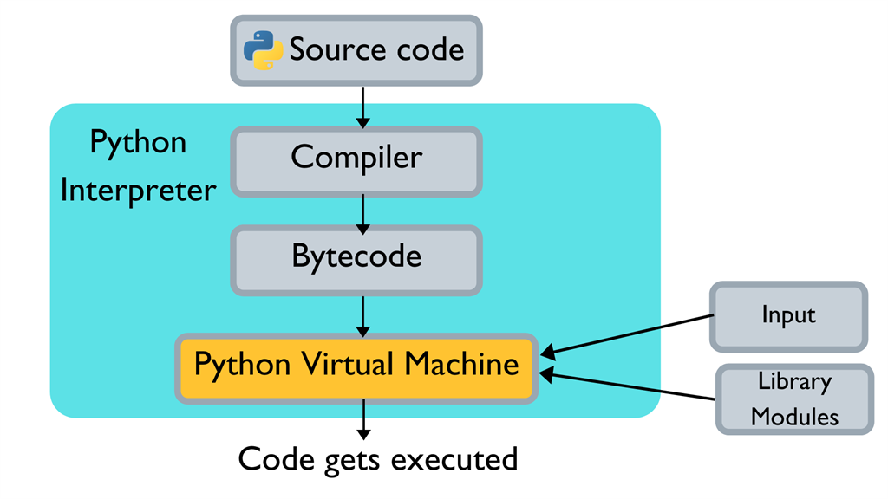
Introduction to Python Programming
What is Python?
object-oriented, and dynamic programming language
Why do we need Python?
Interpreted and Interactive
Platform independent
High - level language
supports multiple programming paradigms,
including Procedural, Object Oriented and
Functional programming language.
emphasizes code readability with the use of
significant indentation.
History of Python
Developed by Guido van Rossum during 1991
Named from Monte Python’s Flying circus, BBC show
Notes:
Characteristics of Python:
supports functional and structured programming methods as well as OOPs.
used as a scripting language or can be compiled to bytecode for building large applications.
provides very high-level dynamic data types and supports dynamic type checking.
supports automatic garbage collection.
Easy integration with C, C++, COM, ActiveX, CORBA, and Java.
Applications of Python:
Easy-to-read, learn and maintain
A broad standard library
Interactive Mode.
Portable and Extendable
Scalable.
Basic Program and Syntax:
>>> print ("Hello, World!")
o/p: Hello, World!
Please Note:
Python files have extension .py
Python is case-sensitive programming language.
Blocks of code are denoted by line indentation
Quotations in Python
Python accepts single ('), double (") and triple (''' or """) quotes to denote string literals, as long as the same type of quote starts and ends the string
>>> print(“a”,’apple’,’’’This is a paragraph. So it contains multiple lines’’’)
o/p: a apple This is a paragraph. So it contains multiple lines
Comments in Python
It supports single-line and multi-line comments
>>> #This is a comment
>>> ’’’
>>> This is multiline comments.
>>> We can use triple quotations.
>>> ’’’
To print any string within quotations (either single/double):
>>> print(“ ‘Hi’ “) → ‘Hi’
>>> print(‘ “ Hello“ ’) → “Hello”
To print in new line:
>>> print(“\n”) → empty line
>>> print(“Hello \nWorld”) → Hello
World
To print with tab space between strings:
>>> print(“Hello \t Friends”) → Hello Friends
To print any user-defined strings within quotations/special characters/symbols:
>>> a = input() #i/p: Good!
>>> print(“ \’a\’ ”) → ‘Good!’
>>> print(“ \@ a “) → @Good!
Please note that if we have to print any strings within quotes/special characters, please write back slash(\) followed by any quote/special characters before and after the user defined string within double quotes.
Python do not use any terminators at the end of the statements as it is a line by line interpreter (So no semicolon(;) at the end!)
Variables:
A Python variable do not need explicit declaration to reserve memory space or you can say to create a variable.
It is created automatically when you assign a value to it.
The equal sign (=) is used to assign values to variables.
The operand to the left of the = operator is the name of the variable and the operand to the right of the = operator is the value stored in the variable.
There are certain rules which should be taken care while naming a Python variable:
A variable name must start with a letter or the underscore character
It cannot start with a number or any special character like $, (, * % etc.
It can only contain alphanumeric characters and underscores (A-z, 0-9, and _ )
They are case-sensitive which means Name and NAME are two different variables in Python.
Reserved keywords cannot be used naming the variable.
For example,
>>> counter = 100 # Creates an integer variable
>>> miles = 1000.0 # Creates a floating point variable
>>> name = "Apple" # Creates a string variable
>>> print(counter) → 100
>>> print(miles) → 1000.0
>>> print(name) → Apple
To delete a Variable,
>>> del counter
Multiple Assignment of Variables:
>>> a=b=c =100
>>> print(a,b,c) → 100 100 100
>>> a,b,c = 100,1000.1,”A”
>>> print(a,b,c) → 100 1000.1 A
Data types:
used to define the type of a variable.
It defines what type of data we are going to store in a variable.
The data stored in memory can be of many types.
For example,
a person's age is stored as a numeric value
his or her address is stored as alphanumeric characters.
Python has various built-in data types as follows:
Numeric - int, float, complex
String - str
Sequence - list, tuple, range
Binary - bytes, bytearray, memoryview
Mapping - dict
Boolean - bool
Set - set, frozenset
None - NoneType
Numeric Data Type:
Python numeric data types store numeric values.
Number objects are created when you assign a value to them.
For example −
>>> var1 = 1
>>> var2 = 10
>>> var3 = 10.023
Python supports four different numerical types as follows,
int (signed integers)
long (long integers, they can also be represented in octal and hexadecimal)
float (floating point real values)
complex (complex numbers)
Examples
Here are some examples of numbers −
int long float complex
10 51924361L 0.0 3.14j
100 -0x19323L 15.20 45.j
-786 0122L -21.9 9.322e-36j
080 0xDEFABCECBDAECBFBAEl 32.3+e18 .876j
-0490 535633629843L -90. -.6545+0J
-0x260 -052318172735L -32.54e100 3e+26J
0x69 -4721885298529L 70.2-E12 4.53e-7j
Python allows you to use a lowercase l with long, but it is recommended that you use only an uppercase L to avoid confusion with the number 1.
Python displays long integers with an uppercase L.
A complex number consists of an ordered pair of real floating-point numbers denoted by x + yj, where x and y are the real numbers and j is the imaginary unit.
Example
Following is an example to show the usage of Integer, Float and Complex numbers:
# integer variable.
>>> a=100
>>> print("The type of variable having value", a, " is ", type(a))
# float variable.
>>> b=20.345
>>> print("The type of variable having value", b, " is ", type(b))
# complex variable.
>>> c=10+3j
>>> print("The type of variable having value", c, " is ", type(c))
Python String Data Type
Python Strings are identified as a contiguous set of characters represented in the quotation marks.
It allows for either pairs of single or double quotes. Subsets of strings can be taken using the slice operator ([ ] and [:] ) with indexes starting at 0 in the beginning of the string and working their way from -1 at the end.
The plus (+) sign is the string concatenation operator and the asterisk (*) is the repetition operator in Python.
For example −
>>> str = 'Hello World!'
>>> print (str) # Prints complete string
>>> print (str[0]) # Prints first character of the string
>>> print (str[2:5]) # Prints characters starting from 3rd to 5th
>>> print (str[2:]) # Prints string starting from 3rd character
>>> print (str * 2) # Prints string two times
>>> print (str + "TEST") # Prints concatenated string
o/p:
Hello World!
H
llo
llo World!
Hello World!Hello World!
Hello World!TEST
Boolean Data Types:
Python boolean type is one of built-in data types which represents one of the two values either True or False.
Python bool() function allows you to evaluate the value of any expression and returns either True or False based on the expression.
Example:
>>> a = True
# display the value of a
>>> print(a)
Data Type Conversion / TYPE CAST:
To perform conversions between the built-in data types.
To convert data between different Python data types, you simply use the type name as a function.
Conversion to int
To convert number, float and string into integer data type:
>>> a = int(1) # a will be 1
>>> b = int(2.2) # b will be 2
>>> c = int("3") # c will be 3
>>> print (a)
>>> print (b)
>>> print (c)
o/p:
1
2
3
Conversion to float:
To convert number, float and string into float data type:
>>> a = float(1) # a will be 1.0
>>> b = float(2.2) # b will be 2.2
>>> c = float("3.3") # c will be 3.3
>>> print (a)
>>>print (b)
>>> print (c)
o/p:
1.0
2.2
3.3
Conversion to string:
To convert number, integer, ,float into string data type:
>>> a = str(1) # a will be "1"
>>> b = str(2.2) # b will be "2.2"
>>> c = str("3.3") # c will be "3.3"
>>> print (a)
>>> print (b)
>>> print (c)
o/p:
1
2.2
3.3
There are several built-in functions to perform conversion from one data type to another.
These are some of the functions return a new object representing the converted value.
ord(x) - Converts a single character to its integer value.
chr(x) - Converts an integer to a character.
General Syntax: data_type(variable)
>>> a = 12.34
>>> print(int(a)) → 12
ASCII conversion:
Integer to character
>>> A = int(input()) → 122
>>> print(chr(A)) → z
Character to integer
>>> A = input() → A
>>> print(ord(A))
Here, ord is a special function used in python to convert character input to an integer value
Math Functions:
A built-in module that you can use for mathematical tasks
import math → first we need to import math into a program
math.ceil(1.234) - to get round off to higher value
math.floor(1.234) - to get round off to lower value
math.sin(x) / math.cos(x) / math.tan(x) - return sine / cosine / tangent of a number
math.factorial(x) - to return factorial of a number
math.gcd(x,y) - returns the gcd/hcf of two numbers
math.log(x) - returns the log of a number
math.sqrt(x) - returns the square root of a number
math.pow(x,y) - returns the power of a number
To print the floating value with 2 decimal places :
>>> num = float(input())
>>> print(“%.2f”%num)

Slide 4
Operators
Operators are the symbols which can manipulate the value of operands, used for the purpose of logical, arithmetic and various other operations.
4 + 5 = 9 ⇒ 4 and 5 are called operands and + is called operator.
Arithmetic Operators → +,-,*,/,//,**,%
Comparison (Relational) Operators → >,<,>=,<=,==,!=
Assignment Operators → +=,-=,*=,/=,...
Logical Operators → and, or, not
Bitwise Operators → &, |, ~(NOT),^(XOR), <<(left shift), >>(right shift)
Membership Operators → in, not in
Identity Operators → is, is not
Notes:
Python Arithmetic Operators:
Used to perform mathematical operations on numerical values.
These operations are Addition, Subtraction, Multiplication, Division, Modulus, Exponents and Floor Division.
Operator Name Example
+ Addition 10 + 20 = 30
- Subtraction 20 – 10 = 10
* Multiplication 10 * 20 = 200
/ Division 20 / 10 = 2
% Modulus 22 % 10 = 2
** Exponent 4**2 = 16
// Floor Division 9//2 = 4
Example:
>>> a = 21
>>> b = 10
# Addition
>>> print ("a + b : ", a + b) → 31
# Subtraction
>>> print ("a - b : ", a - b) → 11
# Multiplication
>>> print ("a * b : ", a * b) → 210
# Division
>>> print ("a / b : ", a / b) → 2.1
# Modulus
>>> print ("a % b : ", a % b) → 1
# Exponent
print ("a ** b : ", a ** b) → 16679880978201
# Floor Division
>>> print ("a // b : ", a // b) → 2
Comparison Operators:
To compare the values on either sides of them and decide the relation among them.
They are also called relational operators.
These operators are equal, not equal, greater than, less than, greater than or equal to and less than or equal to.
Operator Name Example
== Equal 4 == 5 is not true.
!= Not Equal 4 != 5 is true.
> Greater Than 4 > 5 is not true.
< Less Than 4 < 5 is true.
>= Greater than or Equal to 4 >= 5 is not true.
<= Less than or Equal to 4 <= 5 is true.
Example
>>> a = 4
>>> b = 5
# Equal
>>> print ("a == b : ", a == b) → False
# Not Equal
>>> print ("a != b : ", a != b) → True
# Greater Than
>>> print ("a > b : ", a > b) → False
# Less Than
>>> print ("a < b : ", a < b) → True
# Greater Than or Equal to
>>> print ("a >= b : ", a >= b) → False
# Less Than or Equal to
>>> print ("a <= b : ", a <= b) → True
Assignment Operators:
To assign values to variables.
These operators include simple assignment operator, addition assign, subtraction assign, multiplication assign, division and assign operators etc.
Operator Name Example
= Assignment Operator a = 10
+= Addition Assignment a += 5 (Same as a = a + 5)
-= Subtraction Assignment a -= 5 (Same as a = a - 5)
*= Multiplication Assignment a *= 5 (Same as a = a * 5)
/= Division Assignment a /= 5 (Same as a = a / 5)
%= Remainder Assignment a %= 5 (Same as a = a % 5)
**= Exponent Assignment a **= 2 (Same as a = a ** 2)
//= Floor Division Assignment a //= 3 (Same as a = a // 3)
Example
# Assignment Operator
>>> a = 10
# Addition Assignment
>>> a += 5
>>> print ("a += 5 : ", a) → 105
# Subtraction Assignment
>>> a -= 5
>>> print ("a -= 5 : ", a) → 100
# Multiplication Assignment
>>> a *= 5
>>> print ("a *= 5 : ", a) → 500
# Division Assignment
>>> a /= 5
>>> print ("a /= 5 : ",a) → 100.0
# Remainder Assignment
>>> a %= 3
>>> print ("a %= 3 : ", a) → 1.0
# Exponent Assignment
>>> a **= 2
>>> print ("a **= 2 : ", a) → 1.0
# Floor Division Assignment
a //= 3
print ("a //= 3 : ", a) → 0.0
Bitwise Operators:
Bitwise operator works on bits and performs bit by bit operation.
if a = 60; and b = 13;
Now in the binary format their values will be 0011 1100 and 0000 1101 respectively.
>>> a = 0011 1100
>>> b = 0000 1101
>>> a&b = 12 (0000 1100)
>>> a|b = 61 (0011 1101)
>>> a^b = 49 (0011 0001)
>>> ~a = -61 (1100 0011)
>>> a << 2 = 240 (1111 0000)
>>> a>>2 = 15 (0000 1111)
Operator Name Example
& Binary AND Sets each bit to 1 if both bits are 1
| Binary OR Sets each bit to 1 if one of two bits is 1
^ Binary XOR Sets each bit to 1 if only one of two bits is 1
~ Binary Ones Complement Inverts all the bits
<< Binary Left Shift Shift left by pushing zeros in from the right and let the leftmost bits fall off
>> Binary Right Shift Shift right by pushing copies of the leftmost bit in from the left, and let the rightmost bits fall off
Example:
>>> a = 60 # 60 = 0011 1100
>>> b = 13 # 13 = 0000 1101
# Binary AND
>>> c = a & b # 12 = 0000 1100
>>> print ("a & b : ", c)
# Binary OR
>>> c = a | b # 61 = 0011 1101
>>> print ("a | b : ", c)
# Binary XOR
>>> c = a ^ b # 49 = 0011 0001
>>> print ("a ^ b : ", c)
# Binary Ones Complement
>>> c = ~a; # -61 = 1100 0011
>>> print ("~a : ", c)
# Binary Left Shift
>>> c = a << 2; # 240 = 1111 0000
>>> print ("a << 2 : ", c)
# Binary Right Shift
>>> c = a >> 2; # 15 = 0000 1111
>>> print ("a >> 2 : ", c)
o/p:
a & b : 12
a | b : 61
a ^ b : 49
~a : -61
a >> 2 : 240
a >> 2 : 15
Logical Operators:
Operator Description Example
and Logical AND If both the operands are true then condition becomes true. (a and b) is true.
or Logical OR If any of the two operands are non-zero then condition becomes true. (a or b) is true.
not Logical NOT Used to reverse the logical state of its operand. Not(a and b) is false.
Membership Operator:
To check for membership in a sequence, such as strings, lists, or tuples
in → x in y (if x is a member of y, returns true/1)
not in → x not in y (if x is not a member of y returns true/1)
Identity Operator:
compare the memory locations of two objects
is → x is y (if id(x) equals id(y), returns true/1)
is not → x is not y (if id(x) is not equal to id(y), returns true/1)

Slide 5
Decision Statements
To evaluate multiple expressions/conditions which produce TRUE or FALSE as outcome.
To determine which action to take and which statements to execute if outcome is TRUE or FALSE otherwise
Example:
Facebook account creation - to check the age criteria
if
if .. else
elif ladder
Nested statements
Notes:
1. if statement:
-> must case in our problem
syntax:
if(condition):
statement 1
statement 2
...
Eg: License
age = int(input())
if(age>=18):
print("You can apply for License!!")
2. if-else statement:
-> either or option
if(condition):
statement
else:
statement
Eg: Pass or Fail
3. Nested-if
-> Many conditions -> but previous condition needs to be true to check
my current condition
-> else is optional
if(condition 1):
statement
if(condition 2):
statement
if(condition 3):
statement
else:
statement 3 else
else:
statement 2 else
else:
statement 1 else
Example: Interview selection
4. else-if or ladder-if or elif or cascaded-if:
-> multiple conditions, but first condition needs to be false to go to the next
condition.
-> else is optional
if(condition 1):
statement 1
elif(condition 2):
statement 2
elif(condition 3):
statement 3
else:
final statement
Ex: Grading System
grade = float(input())
if(grade>=9.1 and grade<=10.0):
print("A+")
elif(grade>=8.1 and grade<=9.0):
print("A")
elif(grade>=7.1 and grade<=8.0):
print("B")
else:
print("C")

Slide 6
Control Structures
statements are executed sequentially, when we need to execute a block of code several number of times.
for
while
nested loop
Example:
To print a sequence of numbers
To select in an interview (to clear all the rounds step by step to get the offer in a company)
Notes:
Loops:
-> to repeat the same step for several time... we will use loops.
-> 2 types of loops:
-> for loop
-> When we know the number of iteration. we will use for loop.
Syntax:
for i in range(start, end, iteration):
statement 1
statement 2
......
for i in range(5):
print("Hello")
-> while loop
-> We will use the while loop, when we don't know the number of iterations.
Syntax:
while(condition):
statement 1
statement 2
......
iteration
'''
i/p:
3
o/p:
Hello
Hello
Hello
Write a program to count the number of digits in a given number:
ip: 21342
op: Invalid
ip: 343
op: 3
constraints:
-1000 >= n >= 1000
21342 => 21342//10 => 2134; count+=1
2134 => 2134//10 => 213
213 => 213//10 => 21
21 => 21//10 => 2
2 => 2//10 => 0
343 => 343//10 => 34
34 => 34//10 => 3
3 => 3//10 => 0
while(condition):
statements
.....
do
statements
....
while(condition):
'''
n = int(input())
if(n>=-1000 and n<=1000):
if(n==0):
print(1)
else:
count=0
while(n!=0):
count+=1
n = (int)(n/10)
print(count)
else:
print("Invalid")
'''
n=21342 => 2134 => 213 => 21
count=0 => 1 => 2 => 3 => 4 => 5
while(21342!=0) true
count+=1 => count = 0 + 1 => 1
n = 21342//10 => 2134
while(2134!=0) true
count+=1 => count = 1 + 1 => 2
n=n//10 => n = 2134//10 => 213
while(213!=0) true
count+=1 => 3
n=n//10 => 213//10 => 21
while(21!=0) true
count+=1 => 4
n=n//10 => n=21//10 => 2
while(2!=0) true
count+=1 => 5
n=n//10 => n=2//10 => 0
while(0!=0) false
'''
do-while loop is not applicable in python, because we can't jump back from one location to another after execution because of interpretor.
indentation created a new body of the loops. if the loop repeats within the body it will accept. other wise it will not be executed.
do
statement
statement
while(condition):
statement.
So, if you check here, statements are given above the while, which cannot be traced back from the body of loop. So, that's why do while is not applicable in python.
1 break statement: Terminates the loop statement.
2 continue statement: Causes the loop to skip the remainder of its body and immediately retest its condition prior to reiterating.
3 pass statement: when a statement is required syntactically but you do not want any command or code to execute.

Slide 7
Series & Patterns
Series:
-> it's a sequence of number with a common difference.
Check points
1. starting value, end value , n
2. Difference
Patterns:
Rules:
1. find the number of rows in the given pattern
2. find the number of values in each row
3. how many loops you are going to use
4. logic
Notes:
SERIES:
1. 1 2 3 4 5 6 7 ......
ip: 4
op: 1 2 3 4
ip: 5
op: 1 2 3 4 5
st = 1
diff = 1
no.of.values in row => 4 => given input
=> 5 => given input
n=int(input())#4
st,diff=1,1
for i in range(n):
print(st,end=" ")
st = st + diff
n=4
st=1 => 2 => 3 => 4
diff=1
for i in range(n):
op: 1 2 3 4
i=0; 0<4 true
print(st,end=" ")
st = 1 + 1 => 2
i=1; 1<4 true
print(st,end=" ")
st = 2 + 1 => 3
i=2; 2<4 true
print(st,end=" ")
st = 3 + 1 => 4
i=3; 3<4 true
print(st,end=" ")
st = 4 + 1 => 5
i=4; 4<4 false
2. 2 4 6 8 10 .......
ip: 4
op: 2 4 6 8
ip: 5
op: 2 4 6 8 10
st = 2
diff = 2
no.of.values in row => 4 => given input
=> 5 => given input
n=int(input())#4
st,diff=2,2
for i in range(n):
print(st,end=" ")
st = st + diff
3. 1 1 2 3 3 5 4 7 5 9 ......
ip: 5
op: 1 1 2 3 3
ip: 10
op: 1 1 2 3 3 5 4 7 5 9
split the series into even position values and odd position values.
odd: 1 2 3 4 5 .... => 1
even: 1 3 5 7 9 .... => 2
st=1, diff=1
st=1, diff=2
n=int(input())#4
sto,ste, = 1,1
diffo,diffe = 1,2
for i in range(1,n+1):
if(i%2==0):
print(ste,end=" ")
ste = ste + diffe
else:
print(sto,end=" ")
sto = sto + diffo
op: 1 1 2 3 3
n = 5
sto = 1 => 2 => 3 => 4
ste = 1 => 3 => 5
diffo = 1
diffe = 2
i=1, 1<6 true
if(1==0) false
else:
print(Sto,end=" ")
sto = 1 + 1 => 2
i=2, 2<6 true
if(0==0) true
print(ste,end=" ")
ste = 1 + 2 => 3
i=3; 3<6 true
if(1==0) false
else:
print(sto,end=" ")
sto = 2 + 1 => 3
i=4, 4<6 true
if(0==0) true
print(ste,end=" ")
ste = 3 + 2 => 5
i=5, 5<6 true
if(1==0) false
else:
print(Sto)
sto = 3 + 1 => 4
i=6, 6<6 false
4. 2 6 14 26 42 62 ......
st = 2
diff = 4, 8, 12, 16, 20, ....
n=int(input())#4
st = 2
diff = 4
for i in range(1,n+1):
print(st,end=" ")
st = st + diff
diff = diff + 4;
op: 2 6 14 26
n=4
st = 2 => 6 => 14 => 26
diff = 4 => 8 => 12 => 16
i=1, 1<5 true
print(st, end=" ")
st = st + diff => 2 + 4 => 6
diff = diff + 4 => 4 + 4 => 8
i=2, 2<5 true
print(st,end=" ")
st =st + diff => st = 6 + 8 => 14
diff = diff + 4 => 8 + 4 => 12
i=3, 3<5 true
print(st,end=" ")
st = st + diff =>14 + 12 => 26
diff = diff + 4 => 12 + 4 => 16
i=4, 4<5 true
print(st,end=" ")
st = st + diff => 26 + 16 => 42
diff = diff + 4 => 16 + 4 => 20
i=5, 5<5 false
PATTERNS:
1. n = 4
****
****
****
****
1. rows => 4 => n
2. values in each row
*
1 -> 4 => n
2 -> 4 => n
3 -> 4 => n
4 -> 4 => n
3. loops => 2 loops (nested)
-> rows
-> stars
n=int(input())
#rows
for i in range(1,n+1):
print('*'*n)
or
n=int(input())
#rows
for i in range(1,n+1):
#star
for j in range(n):
print('*',end="")
print()
2. n=4
*
**
***
****
1. rows = 4 => n
2. values
*
1 -> 1 => stars based on value of row
2 -> 2
3 -> 3
4 -> 4
n=int(input())
#rows
for i in range(1,n+1):
#star
for j in range(i):
print('*',end="")
print()
'''
n=4
i=1, 1<5 true
j=0, 0<1 true
print(*)
j=1, 1<1 false
i=2, 2<5 true
j=0, 0<2 true
print(*)
j=1, 1<2 true
print(*)
j=2, 2<1 false
'''
or
n=int(input())
#rows
for i in range(1,n+1):
print('*'*i)
3. n=4
****
***
**
*
row = 4
values
4 -> 4
3 -> 3
2 -> 2
1 -> 1
n=int(input())
#rows
for i in range(n,0,-1):
print('*'*i)
or
n=int(input())
#rows
for i in range(n,0,-1):
#star
for j in range(i):
print('*',end="")
print()
4. n=4
*
**
***
****
***
**
*
n=int(input())
#upper
#rows
for i in range(1,n+1):
#star
for j in range(i):
print('*',end="")
print()
#lower
#rows
for i in range(n-1,0,-1):
#star
for j in range(i):
print('*',end="")
print()
or
n=int(input())
#upper
#rows
for i in range(1,n+1):
print('*'*i)
#lower
#rows
for i in range(n-1,0,-1):
print('*'*i)
5.
n=4
*
***
*****
*******
1. rows = 4 => n
2. values
*
1 -> 1 => = 1
2 -> 3 => 2*2-1 = 3
3 -> 5 => 2*3-1 = 5
4 -> 7 => 2*4-1 = 7
odd: 2*n-1 => 4 => 2*4-1 => 7
even: 2*n => 3 => 3*2 => 6
n=int(input())
#rows
for i in range(1,n+1):
#values
for j in range((2*i)-1):
print("*",end="")
print()
'''
n=4
op:
*
***
i=1, 1<5 True
j=0, 0<1 true
print(*)
j=1, 1<1 false
print()
i=2, 2<5 true
j=0, 0<3 true
print(*)
j=1, 1<3 true
print(*)
j=2, 2<3 true
print(*)
j=3, 3<3 false
'''
or
n=int(input())
#rows
for i in range(1,n+1):
print("*"*((2*i)-1))
6.
n=4
*
***
*****
*******
1. rows = 4 => n
2. values:
' ' *
1 -> 3 = 4-1 1
2 -> 2 = 4-2 3
3 -> 1 = 4-3 5
4 -> 0 = 4-4 7
n-i (2*i)-1
n=int(input())
#rows
for i in range(1,n+1):
print((" "*(n-i))+('*'*((2*i)-1)))
or
n=int(input())
#rows
for i in range(1,n+1):
#space
for j in range(n-i):
print(' ',end="")
#star
for j in range((2*i)-1):
print('*',end="")
print()
'''
n=4
op:
*
***
i=1, 1<5 true
space
j=0, 0<3 true
print(' ')
j=1, 1<3 true
print(' ')
j=2, 2<3 true
print(' ')
j=3, 3<3 false
star
j=0, 0<1 true
print(*)
j=1, 1<1 false
i=2, 2<5 true
space
j=0, 0<2 true
print(' ')
j=1, 1<2 true
print(' ')
j=2, 2<2 false
star
j=0, 0<3 true
print(*)
j=1, 1<3 true
print(*)
j=2, 2<3 true
print(*)
j=3, 3<3 false
'''
7.
n=4
*
***
*****
*******
*****
***
*
n=int(input())
#upper
#rows
for i in range(1,n+1):
#space
for j in range(n-i):
print(' ',end="")
#star
for j in range((2*i)-1):
print('*',end="")
print()
#lower
#rows
for i in range(n-1,0,-1):
#space
for j in range(n-i):
print(' ',end="")
#star
for j in range((2*i)-1):
print('*',end="")
print()

Slide 8
LIST
-> list is used to store collection of values in a single memory reference.
-> []
-> will allow duplicate values
-> it can store multiple datatype values.
-> mutable type (after initialization we can change the values)
syntax:
-> a = []
-> a = list()
Notes:
Sample input:
10
20
30
40
50
Sample output:
10 20 30 40 50
'''
a = [10, 20, 30, 40, 50]
for i in a:
print(i,end=" ")
Different types of predefined functions:
1. append():
-> used to add a new value to our list.
-> it will add only at the end of my list
-> variable_name.append(variable/value)
2. map():
-> used to get the input in a single line including spaces
-> map(datatype, input().split())
'''
Sample input:
5
10 20 30 40 50
Sample output:
10 20 30 40 50
'''
n = int(input())#5
#create a list variable
a = list(map(int,input().split()))
print(a)
3. len():
-> length function
-> used to find the number of values in the given list
-> len(variable)
a = list(map(float,input().split()))
print(len(a))
4. sum():
-> sum function is used to add the integer values and float values in the given list.
-> for string list, sum() cannot be used
-> sum(variable)
a = list(map(float,input().split()))
print(sum(a))
or
without using sum()
a = list(map(int,input().split()))
sum=0
for i in a:
sum+=i
print(sum)
5. max():
-> used to find the maximum value in my list.
-> if the list of string type, it will convert it into integer and checks the maximum value.
-> if the list of character values, it will convert it into ascii values and check for the maximum value.
-> max(variable)
a = list(map(str,input().split()))
print(max(a))
6. min():
-> used to find the minimum value in my list.
-> if the list of string type, it will convert it into integer and checks the minimum value.
-> if the list of character values, it will convert it into ascii values and check for the minimum value.
-> min(variable)
a = list(map(str,input().split()))
print(min(a))
7. slicing:
-> i can access the values based in indexes.
-> variable[starting_index : ending_index : iteration]
a = [10,20,30]
print(a[:2])
print(a[::-1])
print(a[-1])
print(a[2:3])
8. index():
-> used to find the given value index in the given list.
-> find the first occurance of the search element in the list.
-> variable.index(value)
a = list(map(str,input().split()))
print(a.index("30"))
9. to replace the values:
a = list(map(str,input().split()))
print(a[0])
a[a.index("10")] = "20"
print(a[0])
input: 10 20 30 40 50
output:
10
20
10. sort():
-> arrange the list values in ascending order.
-> variable.sort()
-> arrange the list values in descending order.
-> variable.sort(reverse=True)
11. count():
-> used to count, how many times the given value is present in the list.
-> variable.count(value)

Slide 9
TUPLE
-> is also used to store different data values in a sequence.
-> used parenthesis to declare the variable as tuple.
-> We cannot change the values in our tuples, which means it is immutable.
-> it allows duplicate values.
-> no concatenation for integer values (only acceptable by strings)
-> append() is not acceptable in tuples.
-> we cannot use sort in tuple, because we cannot change the values of index after initialization.
a = ()
a = tuple()
Notes:
n = int(input())
a = []
for i in range(n):
x = int(input())
a.append(x)
b = tuple(a)
print(b)
-> when i need to get the input values in a single line with space separated.
a = tuple(map(int,input().split()))
print(a)
Tuple methods
-> len()
-> sum()
-> max()
-> min()
-> index()
-> count()

Slide 10
SET
-> used to store different data values in sequence.
-> Set will not allow duplicate values.
-> unordered list expression (there is no constant index positions)
-> {} -> is also used in dictionary
-> set()
Notes:
input:
1. add()
-> used to insert the new value to our set.
-> variable.add(value)
n=int(input())
a=set({})
for i in range(n):
x = int(input())
a.add(x)
print(a)
2. get the input in a single line with space.
'''
ip: 1 2 3 4 5
op={1,2,3,4,5}
'''
a=set(map(int,input().split()))
print(a)
3. How to find the length of the set.
'''
ip: 1 2 3 4 5
op=5
'''
a=set(map(int,input().split()))
print(len(a))
4. max()
'''
ip: 1 2 3 4 5
op=5
'''
a=set(map(int,input().split()))
print(max(a))
5. min()
'''
ip: 1 2 3 4 5
op=1
'''
a=set(map(int,input().split()))
print(min(a))
6. sum()
'''
ip: 1 2 3 4 5
op=5
'''
a=set(map(int,input().split()))
print(sum(a))
7. index() and count() both are not acceptable by set.
8. difference() -> print the uncommon values in the two given sets.
-> set1.difference(set2)
'''
ip:
1 2 3 4 5
3 4 5 6 7
op:
{1, 2}
'''
a=set(map(int,input().split()))
b=set(map(int,input().split()))
print(a.difference(b))
9. intersection() - print the common values in the two given sets.
-> set1.intersection(set2)
'''
ip:
1 2 3 4 5
3 4 5 6 7
op:
{3, 4, 5}
'''
a=set(map(int,input().split()))
b=set(map(int,input().split()))
print(b.intersection(a))
10. pop() -> remove the first value incase of integer and remove random value incase of string and return the deleted value.
-> variable.pop()
a=set(map(int,input().split()))
print(a.pop())
print(a)
output:
1 2 3 4 5
1
{2, 3, 4, 5}
11. remove() -> remove a specific value from the set but if the value is not present it will throw a keyerror.
-> variable.remove(value)
12. discard() -> remove a specific value from the set but if the value is not present it will return the exact set values.
-> -> variable.discard(value)
13. clear() -> used to delete all the values of my set
-> variable.clear()
14. union() -> it will merge the 2 given sets.
-> set1.union(set2)
-> answer will be returned as a new set.
a=set(map(int,input().split()))
b=set(map(int,input().split()))
print(a.union(b))
15. update() -> it will merge the 2 given sets.
-> set1.update(set2)
-> answer will be stored back in set1 variable.
a=set(map(int,input().split()))
b=set(map(int,input().split()))
b.update(a)
print(b)

Slide 11
DICTIONARY
-> Key and values
-> Keys: just the name for values
-> values: are the data elements that we are going to store.
-> {}
-> dict()
Syntax:
a = {key1: value1, key2: value2, key3:value3,....}
Notes:
1. keys()
-> to get the key names alone and return the keys as list.
-> variable.keys()
2. values()
-> to get the values alone from the dictionary.
-> it will return as list
-> variable.values()
3. User input:
a = {}
n=int(input())#3
for i in range(n):
k = input()
v = int(input())
a[k] = v;
print(a)
3
a
10
b
20
c
30
output => {'a': 10, 'b': 20, 'c': 30}
Single line input for dict:
a = list(map(int,input().split()))
b={}
for i in range(len(a)):
b[i] = a[i]
print(b)
4. length of dict:
->len()
->it will return the number of keys in the given dictionary element.
->len(a)
a = list(map(int,input().split()))
b={}
for i in range(len(a)):
b[i] = a[i]
print(len(b))
5. maximum value in dict:
-> max(variable.values())
-> it will return the maximum value in the values list.
a = list(map(int,input().split()))
b={}
for i in range(len(a)):
b[i] = a[i]
print(max(b.values()))
-> max(variable)
-> it will return the maximum key.
a = list(map(int,input().split()))
b={}
for i in range(len(a)):
b[i] = a[i]
print(max(b))
Functions:
-> min()
-> sum()

Slide 12
STRING
-> group of characters.
-> variable = '' / ""
Methods:
-> concat() => +
-> len() => len(variable)
-> compare() => ==
-> copy() => =
Notes:
-> isalpha()
-> used to check whether the given character is alphabet or not.
-> if it's a alphabet return "true" else "false"
-> variable.isalpha()
a=input()
c=0
for i in a:
if(i.isalpha()):
c+=1
print(c)
ip: Hello, 12345
op: 5
isdigit() -> check whether the given string or character is a number
isalnum() -> check whether the given strings is a mixed of both alphabet and numbers
isspace()-> check whether the given string or character is a space
lower() -> to print the given string in lowercase
islower() -> to check the given string in lowercase
isupper() -> to check the given string in uppercase
upper() -> to print the given string in upper case
swapcase() -> to print the given string in lower case if the input is in upper or vice versa
trim() -> to trim whitespaces before and after the string
split() -> to split the given string using comma
replace(‘v’,’n’) -> to replace v with n
find() -> to find the index of a substring in a string
join() -> returns a new string that is the concatenation of the strings
translate() -> returns a new string with each character in the string replaced
format() -> to create a formatted string from the template string and the supplied values.
count() -> returns the number of occurrences of a substring in the given string.
capitalize() -> returns the capitalized string
casefold() -> to perform case-insensitive string comparison.
__contains__() -> use to check if it contains another string or not. We can also use “in” operator to perform this check

Slide 13
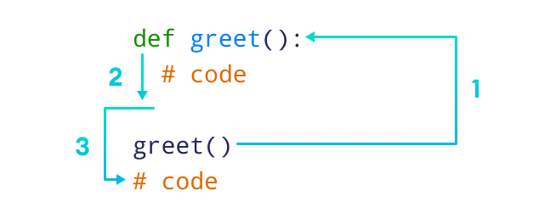
FUNCTIONS
a block of code that performs a specific task
Types of function - two types of functions in Python
Standard library functions - built-in functions, that are available to use
User-defined functions - create our own functions based on our requirements
SYNTAX - User-defined Functions :
def function_name(arguments):
# function body
return
Here, def - keyword ; function_name - any user defined name ; arguments - value passed to function
return (optional) - returns value from a function
Notes:
Example:
1.
# Function definition
def greet():
print('Hello World!')
# call the function
greet()
print(“Welcom!!!”)
2.
# function with two arguments
def add_numbers(num1, num2):
sum = num1 + num2
print('Sum: ',sum)
# function with no argument
def add_numbers():
# code
3.

Slide 14
File Operations & Exception Handling
The key function for working with files in Python is the open() function.
The open() function takes two parameters; filename, and mode.
There are four different methods (modes) for opening a file:
"r" - Read - Default value. Opens a file for reading, error if the file does not exist
"a" - Append - Opens a file for appending, creates the file if it does not exist
"w" - Write - Opens a file for writing, creates the file if it does not exist
"x" - Create - Creates the specified file, returns an error if the file exists
To Open a file,
filename = open(“text file path.txt”)
Notes:
1. Return the 5 first characters of the file:
f = open("demofile.txt", "r")
print(f.read(5))
2. Read one line of the file:
f = open("demofile.txt", "r")
print(f.readline())
3. Read two lines of the file:
f = open("demofile.txt", "r")
print(f.readline())
print(f.readline())
4. Loop through the file line by line:
f = open("demofile.txt", "r")
for x in f:
print(x)
5. Close the file when you are finish with it:
f = open("demofile.txt", "r")
print(f.readline())
f.close()
6. To write to an existing file, you must add a parameter to the open() function:
"a" - Append - will append to the end of the file
"w" - Write - will overwrite any existing content
Example:
Open the file "demofile2.txt" and append content to the file:
f = open("demofile2.txt", "a")
f.write("Now the file has more content!")
f.close()
#open and read the file after the appending:
f = open("demofile2.txt", "r")
print(f.read())
Example
Open the file "demofile3.txt" and overwrite the content:
f = open("demofile3.txt", "w")
f.write("Woops! I have deleted the content!")
f.close()
#open and read the file after the overwriting:
f = open("demofile3.txt", "r")
print(f.read())
Create a New File:
To create a new file in Python, use the open() method, with one of the following parameters:
"x" - Create - will create a file, returns an error if the file exist
"a" - Append - will create a file if the specified file does not exist
"w" - Write - will create a file if the specified file does not exist
Example
Create a file called "myfile.txt":
f = open("myfile.txt", "x")
EXCEPTION HANDLING:
The try block lets you test a block of code for errors.
The except block lets you handle the error.
The else block lets you execute code when there is no error.
The finally block lets you execute code, regardless of the result of the try- and except blocks.
1. Variable not defined error
try:
print(x)
except:
print("An exception occurred")
2. NameError
try:
print(x)
except NameError:
print("Variable x is not defined")
except:
print("Something else went wrong")
3.
try:
print("Hello")
except:
print("Something went wrong")
else:
print("Nothing went wrong")
4.
try:
print(x)
except:
print("Something went wrong")
finally:
print("The 'try except' is finished")
5. Type error
x = "hi"
if not type(x) is int:
raise TypeError("Only integers are allowed")

Slide 15
Data Cleaning & Pre-processing
To collect, clean, and transform data to derive meaningful insights.
How to handle missing data?
1. Drop rows or columns that have a missing value
To drop the rows or columns that contain a missing value
2. Drop rows or columns that have only missing values
3. Drop rows or columns based on a threshold value
“thresh=4” means that the rows that have at least 4 non-missing values will be kept. The other ones will be dropped.
4. Drop based on a particular subset of columns
we can drop the rows that have a missing value in any one of the columns
5. Fill with a constant value
choose a constant value to be used as a replacement for the missing values.
6. Fill with an aggregated value
To use an aggregated value such as mean, median, or mode.
7. Replace with the previous or next value
It is possible to replace the missing values in a column with the previous or next value in that column.
8. Fill by using another data frame
We can also pass another data frame to the fillna function. The values in the new data frame will be used to replace the missing values in the current data frame.

Slide 16
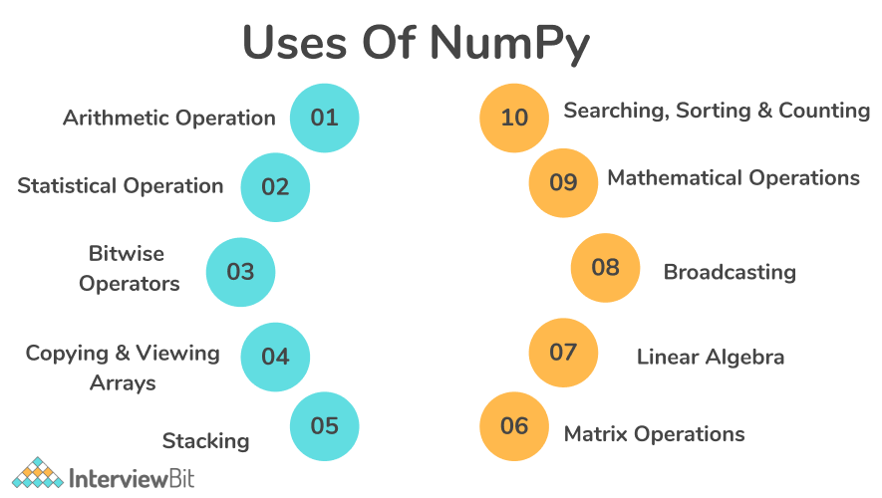
Dataframe concepts - Numpy & Pandas
NumPy - Numerical Python
To perform numerical analysis and data manipulation using NumPy library
Installation of NumPy: pip install numpy
To import Numpy: import numpy as np
Why do we use NumPy? (numpy vs list): NumPy arrays are faster and more compact than Python lists.
An array consumes less memory and is convenient to use.
NumPy uses much less memory to store data and it provides a mechanism of
specifying the data types. We could get optimized code.
Notes:
1. Create a NumPy array.
A = np.array([1,2,3,4,5])
B = np.array([[1,2,3],[4,5,6]])
Shape - Size of Array along each dimension (say no.of rows and no. of columns)
Rank - No. of dimensions (1-d/2-d,..)
np.array() - to create an array ( a = np.array([1,2,3]) → 1,2,3)
np.zeros() - to create an array with elements as zeros ( b = np.zeros(3) → array[0.,0.,0.] )
np.ones() - to create an array with elements as ones( b = np.ones(2) → array[1.,1.,1.] )
np.empty() - to create an array whose initial content is random and depends on the state of the memory. The reason to use empty over zeros is speed (just make sure to fill every element afterwards!)
(np.empty(2) → array([3.14, 42. ]) # may vary)
np.arange() - an array that contains a range of evenly spaced intervals. Either specify the no. of values or the first number, last number, and the step size.
np.arange(4) → array([0, 1, 2, 3])
np.arange(2, 9, 2) → array([2, 4, 6, 8])
np.linspace() - to create an array with values that are spaced linearly in a specified interval:
np.linspace(0, 10, num=5) → array([ 0. , 2.5, 5. , 7.5, 10. ])
dtype - Specifying your data type
While the default data type is floating point (np.float64), you can explicitly specify which data type required using the dtype keyword.
x = np.ones(2, dtype=np.int64)
x
array([1, 1])
2. Access and manipulate elements in the array.
print(A[2]) → 3
3. Create a 2-dimensional array and check the shape of the array.
4. Access elements from the 2D array using index positions.
5. Create an array of type string.
6. Using the arange() and linspace() function to evenly space values in a specified interval.
7. Create an array of random values between 0 and 1 in a given shape.
8. Repeat each element of an array by a specified number of times using repeat() and tile() functions.
Adding, removing, and sorting elements: - np.sort(), np.concatenate()
Sorting an element is simple with np.sort(). You can specify the axis, kind, and order when you call the function.
If you start with this array:
arr = np.array([2, 1, 5, 3, 7, 4, 6, 8])
np.sort(arr)
array([1, 2, 3, 4, 5, 6, 7, 8])
In addition to sort, which returns a sorted copy of an array, you can use:
argsort, which is an indirect sort along a specified axis,
lexsort, which is an indirect stable sort on multiple keys,
searchsorted, which will find elements in a sorted array, and
partition, which is a partial sort.
If you start with these arrays:
a = np.array([1, 2, 3, 4])
b = np.array([5, 6, 7, 8])
You can concatenate them with np.concatenate().
np.concatenate((a, b))
array([1, 2, 3, 4, 5, 6, 7, 8])
Or, if you start with these arrays:
x = np.array([[1, 2], [3, 4]])
y = np.array([[5, 6]])
You can concatenate them with:
np.concatenate((x, y), axis=0)
array([[1, 2],
[3, 4],
[5, 6]])
In order to remove elements from an array, it’s simple to use indexing to select the elements that you want to keep.
How do you know the shape and size of an array?
This section covers ndarray.ndim, ndarray.size, ndarray.shape
ndarray.ndim will tell you the number of axes, or dimensions, of the array.
ndarray.size will tell you the total number of elements of the array. This is the product of the elements of the array’s shape.
ndarray.shape will display a tuple of integers that indicate the number of elements stored along each dimension of the array. If, for example, you have a 2-D array with 2 rows and 3 columns, the shape of your array is (2, 3).
For example, if you create this array:
array_example = np.array([[[0, 1, 2, 3],
[4, 5, 6, 7]],
[[0, 1, 2, 3],
[4, 5, 6, 7]],
[[0 ,1 ,2, 3],
[4, 5, 6, 7]]])
To find the number of dimensions of the array,
array_example.ndim
3
To find the total number of elements in the array,
array_example.size
24
to find the shape of your array,
array_example.shape
(3, 2, 4)
reshape an array - arr.reshape()
will give a new shape to an array without changing the data. Note that when you use the reshape method, the array you want to produce needs to have the same number of elements as the original array. If you start with an array with 12 elements, you’ll need to make sure that your new array also has a total of 12 elements.
If you start with this array:
a = np.arange(6)
print(a)
[0 1 2 3 4 5]
used to reshape your array.
For example, you can reshape the above array to a new array with three rows and two columns:
b = a.reshape(3, 2)
print(b)
[[0 1]
[2 3]
[4 5]]
With np.reshape, you can specify a few optional parameters:
np.reshape(a, newshape=(1, 6))
array([[0, 1, 2, 3, 4, 5]])
a is the array to be reshaped
Indexing and slicing - To index and slice NumPy arrays in the same ways you can slice Python lists.
data = np.array([1, 2, 3])
data[1]
2
data[0:2]
array([1, 2])
data[1:]
array([2, 3])
data[-2:]
array([2, 3])
a = np.array([[1 , 2, 3, 4], [5, 6, 7, 8], [9, 10, 11, 12]])
To print all of the values in the array that are less than 5.
print(a[a < 5])
[1 2 3 4]
for example, numbers that are equal to or greater than 5, and use that condition to index an array.
five_up = (a >= 5)
print(a[five_up])
[ 5 6 7 8 9 10 11 12]
To select elements that are divisible by 2:
divisible_by_2 = a[a%2==0]
print(divisible_by_2)
[ 2 4 6 8 10 12]
To select elements that satisfy two conditions using the & and | operators:
c = a[(a > 2) & (a < 11)]
print(c)
[ 3 4 5 6 7 8 9 10]
You can also make use of the logical operators & and | in order to return boolean values that specify whether or not the values in an array fulfill a certain condition. This can be useful with arrays that contain names or other categorical values.
five_up = (a > 5) | (a == 5)
print(five_up)
[[False False False False]
[ True True True True]
[ True True True True]]
PANDAS:
Pandas is an open-source Python library that provides high-performance, easy-to-use data structure, and data analysis tools for the Python programming language.
Python with pandas is used in a wide range of fields, including academics, retail, finance, economics, statistics, analytics, and many others.
Python pandas is well suited for different kinds of data, such as:
Ordered and unordered time series data
Unlabeled data
Any other form of observational or statistical data sets
Series is a one-dimensional array that can contain any type of data.
We can create a series by using the following constructor:
pandas.Series(data, index, dtype, copy)
COMPARISON PARAMETER PANDAS NUMPY
Developed By: Wes McKinney. Travis Oliphant.
Year Of Release: 2008. 2005.
Primary Objective to Use: data analysis tasks in Python. working with Numerical values and in mathematical functions.
Data Compatibility works well for numeric, alphabets, works better with only numerical data, has efficient storage, and fastly performs mathematical operations
and heterogeneous types of data simultaneously. .
Performance: If the number of rows of the dataset is more than 500K, NumPy can be said to be faster in performance than Pandas,
then the performance of Pandas is better than NumPy. up to fifty thousand (50K) rows and less of the dataset.
(The performance between fifty thousand rows to five hundred thousand rows mostly depends on the type of operation Pandas, and NumPy are going to have to perform.)
Tools: DataFrames and Series are the most powerful tools for Pandas. Arrays are the most powerful tool of NumPy.
Memory Usage: consume more memory compared to NumPy. lesser memory consumption compared to Pandas.
Objects: DataFrames are the two-dimensional (2d) Objects provided by Pandas. NumPy provides n-dimensional arrays, Data Type (dtype), etc. as objects.
Indexing: The indexing of pandas series is significantly slower than the indexing of NumPy arrays. The indexing of NumPy arrays is much faster than the indexing of Pandas arrays.
Usage or Application in Organisations: Trivago, Kaidee, Abeja Inc.,. Instacart, SendGrid, Walmart, Tokopedia, and many more organizations make use of NumPy.

Slide 17
Data Analysis using Excel
Ask
Prepare
Process
Analyze
Share
Act
Notes:
Scenario: Since it was founded in 2013, Bellabeat has grown rapidly and quickly positioned itself as a tech-driven wellness company for women. The company has 5 focus products: bellabeat app, leaf, time, spring and bellabeat membership. Bellabeat is a successful small company, but they have the potential to become a larger player in the global smart device market. Our team have been asked to analyze smart device data to gain insight into how consumers are using their smart devices. The insights we discover will then help guide marketing strategy for the company.
Step 1: ASK
BUSINESS TASK: Analyze FitBit fitness tracker data to gain insights into how consumers are using the FitBit app and discover trends for Bellabeat marketing strategy.
Primary stakeholders: Urška Sršen and Sando Mur, executive team members.
Secondary stakeholders: Bellabeat marketing analytics team
Step 2: PREPARE
Information on Data Source:
1.Data: FitBit Fitness Tracker Data and stored in 18 csv files.
2.30 FitBit users consented to the submission of personal tracker data.
3.Data collected includes physical activity recorded in minutes, heart rate, sleep monitoring, daily activity and steps.
A good data source is ROCCC which stands for Reliable, Original, Comprehensive, Current, and Cited.
Reliable — LOW — Not reliable as it only has 30 respondents
Original — LOW — Third party provider (Amazon Mechanical Turk)
Comprehensive — MED — Data minute-level output for physical activity, heart rate, and sleep monitoring. While the data tracks many factors in the user activity and sleep, but the sample size is small and most data is recorded during certain days of the week.
Current — LOW — Data is 6 years old and may not be relevant
Cited — LOW — Data collected from third party, hence unknown
Overall, the dataset is considered bad quality data and it is not recommended to produce business recommendations based on this data.
Data selection: dailyActivity_merged.csv is selected and copied for analysis.
Tool: We have used Excel for data cleaning, transformation and visualisation.
Step 3: PROCESS
Data cleaning and manipulation:
1.Observe and familiarize with data
2.Check for null or missing values
Create a table called "Fitness" for the whole data.
To identify any null values in the fitness table, we can use a simple formula based on the COUNT function with the IF function.
Formula is: =IF(COUNT(Fitness)>1,"YES","NO")
OUTPUT: No NULL values.
3.We are also going to count unique IDs to confirm whether data has 30 IDs as claimed by the survey
Formula: =SUMPRODUCT(1/COUNTIF(A2:A700,A2:A700))
From the above observations, we noted that:
1.There are Null or missing values as stated under the ‘Non-Null Count’.
2.ActivityDate is wrongly classified as object dtype and has to be converted to datetime64 dtype.
3.There are 33 unique IDs, instead of 30 unique IDs as expected. Some users may have created additional IDs during the survey period.
4.In Column ActivityDate, dates are in " mm-dd-yyyy" format.
Now that we have identified the dirty data, we will then perform data manipulation/transformation.
1.Convert format of ActivityDate to yyyy-mm-dd.
2.Create new column DayOfTheWeek by generating date in the form of day of the week for further analysis.
3.Create new column TotalMins being the sum of VeryActiveMinutes, FairlyActiveMinutes, LightlyActiveMinutes and SedentaryMinutes.
4.Create new column TotalHours by converting new column TotalMins in no. 3 to number of hours.
First off, we will convert ActivityDate from mm-dd-yyyy to yyyy-mm-dd by selecting "yyyy-mm-dd" format in the advanced format option.
Let's create a new column named "Days_of_Week" right side of ActivityDate. To get day of the week we use this formula:=TEXT([@ActivityDate],"dddd")
Creating new column total_minutes being the sum of total time logged by using formula: =[@VeryActiveMinutes]+[@FairlyActiveMinutes]+[@LightlyActiveMinutes]+[@SedentaryMinutes]
Data cleaning and manipulation is completed. Hence, data is now ready to be analyzed.
Step4: ANALYZE:
Let's perform average, min,max using pivot table.
Interpreting statistical findings:
1.On average, users logged 7,637 steps or 5.4km which is not adequate.
As recommended by CDC, an adult female has to aim at least 10,000 steps or 8km per day to benefit from general health, weight loss and fitness improvement.
2.Sedentary users are the majority logging on average 991 minutes or 20 hours making up 81% of total average minutes.
3.Noting that average calories burned is 2,303 calories equivalent to 0.6 pound. Could not be interpreted into detail as calories burned depend on several factors such as the age, weight, daily tasks, exercise, hormones and daily calorie intake.
4.People spent more time, more steps and burnt more calories on Tuesday.
Step 5: SHARE
Frequency of usage across the week:
In this histogram, we are looking at the frequency of FitBit app usage in terms of days of the week.
1.Noting that the frequency dropped on Friday and continued on weekends and Monday.
From the scatter plot, we discovered that:
1.It is a positive correlation.
2.We observed that intensity of calories burned increases when users are at the range of > 0 to 15,000 steps with calories burn rate cooling down from 15,000 steps onwards.
Through scatter plot,
1.A weak positive correlation whereby the increase of hours logged does not translate to more calories being burned. That is largely due to the average sedentary hours being 16:30 hours.
2.we can see a few outliers:
Zero value outliers
From the pie chart,
1.Sedentary minutes takes the biggest slice at 81.3%.
2.This indicates that users are using the FitBit app to log daily activities such as daily commute, inactive movements (moving from one spot to another) or running errands.
3.App is rarely being used to track fitness (ie. running) as per the minor percentage of fairly active activity (1.1%) and very active activity (1.7%). This is highly discouraging as FitBit app was developed to encourage fitness.
Step 6: ACT
What are the trends identified?
Majority of users (81.3%) are using the FitBit app to track sedentary activities and not using it for tracking their health habits.
Users prefer to track their activities during weekdays as compared to weekends - perhaps because they spend more time outside on weekdays and stay in on weekends.
How could these trends help influence Bellabeat marketing strategy?
Educational healthy style campaign can pair with a point-reward incentive system. Users completing the whole week's exercise will receive Bellabeat points on products/memberships.
On weekends, Bellabeat app can also prompt notifications to encourage users to exercise.
Educational healthy style campaign encourages users to have short active exercises during the week, longer during the weekends, especially on Sunday where we see the lowest steps and most sedentary minutes
BASIC MATH FUNCTIONS USING EXCEL:
CONCATENATE(): TO COMBINE TWO COLUMNS INTO ONE -> =CONCATENATE(A1,B1)
LEN(): TO DISPLAY NO. OF CHARACTERS IN EACH CELL -> =LEN(C1)
DAYS(): TO DISPLAY NO. OF CALENDAR DAYS BETWEEN TWO DATES -> =DAYS(END_DATE,START_DATE)
NETWORKDAYS(): TO DISPLAY NO. OF WORKING DAYS BETWEEN TWO DATES THAT IS EXCLUDING WEEKEND -> =NETWORK(START_DATE,END_DATE,[HOLIDAYS])
SUMIFS(): TO SUM DATA BASED ON CRITERIA -> =SUMIFS(SUM_RANGE,RANGE1,CRITERIA1,...)
AVERAGEIFS(): TO AVERAGE DATA BASED ON CRITERIA -> =AVERAGEIFS(AVG_RANGE,RANGE1,CRITERIA1,...)
COUNTIFS(): NO. OF VALUES THAT SATISFY A SET OF CONDITIONS -> =COUNTIFS(RANGE,CRITERIA)
COUNTA(): TO EXAMINE ANY GAPS IN THE DATASET THAT IS TO DETERMINE WHETHER A CELL IS EMPTY OR NOT -> =COUNTA(VALUE1,VALUE2,..)
IF(): TO AUTOMATE DECISION MAKING IN SPREADSHEETS -> =IF(LOGICAL_TEST,[VALUE_IF_TRUE],[VALUE_IF_FALSE])
IFERROR(): TO DISPLAY ERROR OR TO EXECUTE ALTERNATE COMPUTATION; WHAT VALUE TO BE CHECKED AND WHAT ACTION TO BE TAKEN -> IFERROR(VALUE/CONDITION,IF_ERROR)
FIND/SEARCH: TO FIND/SEARCH ANY CHARACTER/WORD WITHIN THE CELL -> =FIND(FIND_TEXT,WITHIN_TEXT) / =SEARCH(FIND_TEXT,WITHIN_TEXT)
LEFT/RIGHT: TO RETRIEVE STATIC DATA FROM CELLS BEGINNING IF IT’S LEFT ELSE FROM END IT’S RIGHT -> =LEFT(TEXT,[NO.OF CHARACTERS]) / =RIGHT(TEXT,[NO.OF CHARACTERS])
COUNT(): TO COUNT THE VALUES WITHIN A SPECIFIC COLUMN -> COUNT(A1:A10)
SUM(): TO SUM THE VALUES -> SUM(A1:A5)

Slide 18
Math for Data Analytics
1. Linear Algebra
Vectors and Spaces
Matrix Transformations
Alternate coordinate systems
2. Statistics
Descriptive Statistics
Inferential Statistics
Hypothesis Testing
3. Probability
Classical Probability
Relative Frequency
Notes:
Linear Algebra:
Scalar: Any single numerical value is a scalar which is denoted by lowercase; For example: n
Vector: An array of numbers(data) is a vector. You can assume a column in a dataset to be a feature vector. There are two types of vectors representation which is row vector and column vector
Matrix: A matrix is a 2-D array of shape (m×n) with m rows and n columns.
Basic Matrix Operations:
Matrix Addition, Subtraction -> A = np.array([[1,2],[3,4]]) B = np.array([[1,2],[3,4]]) A+B = [2 4]
[6 8]
Scalar Multiplication -> n.A = n=3 => [3 6]
[9 12]
import numpy as np
from numpy import linalg as la
A = np.array([[1,2],[3,4]])
print(A) → [1 2]
[3 4]
print(la.det(A)) → returns the determinant of the matrix A
print(la.inv(A)) → returns the inverse of the matrix A (inverse of A - (1/det(A))*adj(A))
print(np.trace(A)) → returns the trace of the matrix A (Trace - sum of diagonal values)
print(np.transpose(A)) → returns the transpose of the matrix A (Transpose - Interchange your matrix rows into column elements and column elements into row elements)
print(la.matrix_power(A,2)) → returns the power of the matrix A to the power 2 (the value of A*A)
print(la.diag(A)) → returns the diagonal values of the matrix A
print(la.matrix_rank(A)) → returns the rank of the matrix A
print(la.eigvals(A)) → returns the eigenvalues of the matrix A (lambda value/roots)
print(la.eig(A)) → returns the eigenvalues and eigenvectors of the matrix A for a non-symmetric matrix
print(la.eigh(A)) → returns the eigenvalues and eigenvectors of the matrix A for a symmetric matrix
Statistics
Statistics is a mathematical method and tool that enables us to answer important questions about data. It is divided into two categories:
Descriptive Statistics - this offers methods to summarise data by transforming raw observations into meaningful information that is easy to interpret and share.
Inferential Statistics - this offers methods to study experiments done on small samples of data and chalk out the inferences to the entire population (entire domain).
statistics and machine learning are two closely related areas of study. Statistics is an important prerequisite for applied machine learning, as it helps us select, evaluate and interpret predictive models.
In isolation, raw observations are just data. We use descriptive statistics to transform these observations into insights that make sense.
Then we can use inferential statistics to study small samples of data and extrapolate our findings to the entire population.
Statistics helps answer questions as follows,
What features are the most important?
How should we design the experiment to develop our product strategy?
What performance metrics should we measure?
What is the most common and expected outcome?
How do we differentiate between noise and valid data?
Defining a Problem Statement
The most crucial part of predictive modeling is the actual definition of the problem that gives us the real objective to pursue.
This helps us decide the type of problem we're dealing with (that is, regression or classification).
And it also helps us decide the structure and types of the inputs, outputs and metrics with regards to the objective.
But problem framing is not always straightforward. If you're new to Machine Learning, it may require significant exploration of the observations in the domain.
Initial Data Exploration
Data exploration involves gaining a deep understanding of both the distributions of variables and the relationships between variables in your data.
In part, domain expertise helps you gain this mastery over a specific type of variable. Nevertheless, both experts and newcomers to the field benefit from actually handling real observations from the domain.
Data Cleaning
Often, the data points you've collected from an experiment or a data repository are not pristine.
The data may have been subjected to processes or manipulations that damaged its integrity. This further affects the downstream processes or models that use the data.
Common examples include missing values, data corruption, data errors (from a bad sensor), and unformatted data (observations with different scales).
If you want to master cleaning methods, you need to learn about outlier detection and missing value imputation.
Data Preparation and setting up transformation pipelines
If data contains errors and inconsistencies, you often can't use it directly for modeling.
First, the data might need to go through a set of transformations to change its shape or structure and make it more suitable for the problem you've defined or the learning algorithms you're using.
Then you can develop a pipeline of such transformations that you apply to the data to produce consistent and compatible input for the model.
Model Selection & Evaluation
A key step in solving a predictive problem is selecting and evaluating the learning method. Estimation statistics help you score model predictions on unseen data.
Experimental design is a subfield of statistics that drives the selection and evaluation process of a model. It demands a good understanding of statistical hypothesis tests and estimation statistics.
Fine-tuning the model
Almost every machine learning algorithm has a suite of hyperparameters that allow you to customise the learning method for your chosen problem framing.
This hyperparameter tuning is often empirical in nature, rather than analytical. It requires large suites of experiments in order to evaluate the effect of different hyperparameter settings on the performance of the model.
General Statistics Skills
How to define statistically answerable questions for effective decision making.
Calculating and interpreting common statistics and how to use standard data visualization techniques to communicate findings.
Understanding of how mathematical statistics is applied to the field, concepts such as the central limit theorem and the law of large numbers.
Making inferences from estimates of location and variability (ANOVA).
How to identify the relationship between target variables and independent variables.
How to design statistical hypothesis testing experiments, A/B testing, and so on.
How to calculate and interpret performance metrics like p-value, alpha, type1 and type2 errors, and so on.
Important Statistics Concepts
Getting Started— Understanding types of data (rectangular and non-rectangular), estimate of location, estimate of variability, data distributions, binary and categorical data, correlation, relationship between different types of variables.
Distribution of Statistic — random numbers, standard error
Data sampling and Distributions — normal distribution, binomial distribution, Poisson and exponential distribution.
Statistical Experiments and Significance Testing— conducting hypothesis tests (Null/Alternate), statistical significance, p-value, alpha, t-tests, degree of freedom, ANOVA, critical values, covariance and correlation,
df.describe() - describes the dataframe with the values of mean, std deviation, min and max and quartiles (25%,50%,75%)
print(df.sum()) - to concatenate if there is string in the column otherwise sum the values of total column
df2 = df[["Age","Rating"]]
print(df2) - if we want specific columns to be printed
print(df2.mean()) to find the mean values (average) for the specified columns in dataframe
print(df2.median()) to find the median values (middle value) for the specified columns in dataframe
print(df2.mode()) to find the mode values (most frequently occurred value) for the specified columns in dataframe
print(df1.std()) to find the standard deviation
print(df1.count()) to count the no. of elements in that column
print(df1.max()) to find the maximum value in that column
print(df1.min()) to find the minimum value in that column
print(df1.cumsum()) to find the cumulative sum of the values in that column
from numpy import mean -> to find mean we need to import mean module from numpy package
from numpy import std -> to find mean we need to import std module from numpy package
from numpy.random import randn -> to use random values in our program, we need to import randn module from numpy.random package
from numpy.random import seed -> to indicate the start value of the random number, we need to import seed module from numpy.random package
from matplotlib import pyplot -> to draw plot install and import matplotlib and then import pyplot
# seed random number generator
seed(1)
# prepare data
data1 = 20 * randn(1000) + 100
data2 = data1 + (10 * randn(1000) + 50)
# summarize
print('data1: mean=%.3f stdv=%.3f' % (mean(data1), std(data1)))
print('data2: mean=%.3f stdv=%.3f' % (mean(data2), std(data2)))
# plot
pyplot.scatter(data1, data2)
pyplot.show()
COVARIANCE:
# calculate the covariance between two variables
from numpy.random import randn
from numpy.random import seed
from numpy import cov
# seed random number generator
seed(1)
# prepare data
data1 = 20 * randn(1000) + 100
data2 = data1 + (10 * randn(1000) + 50)
# calculate covariance matrix
covariance = cov(data1, data2)
print(covariance)
CORRELATION:
# calculate the Pearson's correlation between two variables
from numpy.random import randn
from numpy.random import seed
from scipy.stats import pearsonr
# seed random number generator
seed(1)
# prepare data
data1 = 20 * randn(1000) + 100
data2 = data1 + (10 * randn(1000) + 50)
# calculate Pearson's correlation
corr, _ = pearsonr(data1, data2)
print('Pearsons correlation: %.3f' % corr)
# calculate the spearmans's correlation between two variables
from numpy.random import randn
from numpy.random import seed
from scipy.stats import spearmanr
# seed random number generator
seed(2)
# prepare data
data1 = 20 * randn(1000) + 100
data2 = data1 + (10 * randn(1000) + 50)
# calculate spearman's correlation
corr, _ = spearmanr(data1, data2)
print('Spearmans correlation: %.3f' % corr)
To implement DESCRIPTIVE STATISTICS using EXCEL,
We could select the range of the data in a column and click DATA -> DATA ANALYZE -> DESCRIPTIVE STATISTICS
T-TEST: Python program to implement T-Test on a sample of ages
# Importing the required libraries
from scipy.stats import ttest_1samp
import numpy as np
# Creating a sample of ages
ages = [45, 89, 23, 46, 12, 69, 45, 24, 34, 67]
print(ages)
# Calculating the mean of the sample
mean = np.mean(ages)
print(mean)
# Performing the T-Test
t_test, p_val = ttest_1samp(ages, 30)
print("P-value is: ", p_val)
# taking the threshold value or level of significance (alpha) as 0.05 or 5%
if p_val < 0.05:
print(" We can reject the null hypothesis")
else:
print("We can accept the null hypothesis")
from scipy.stats import ttest_ind
import numpy as np
# Creating the data groups
data_group1 = np.array([12, 18, 12, 13, 15, 1, 7,
20, 21, 25, 19, 31, 21, 17,
17, 15, 19, 15, 12, 15])
data_group2 = np.array([23, 22, 24, 25, 21, 26, 21,
21, 25, 30, 24, 21, 23, 19,
14, 18, 14, 12, 19, 15])
# Calculating the mean of the two data groups
mean1 = np.mean(data_group1)
mean2 = np.mean(data_group2)
# Print mean values
print("Data group 1 mean value:", mean1)
print("Data group 2 mean value:", mean2)
# Calculating standard deviation
std1 = np.std(data_group1)
std2 = np.std(data_group2)
# Printing standard deviation values
print("Data group 1 std value:", std1)
print("Data group 2 std value:", std2)
# Implementing the t-test
t_test,p_val = ttest_ind(data_group1, data_group2)
print("The P-value is: ", p_val)
# taking the threshold value/alpha as 0.05 or 5%
if p_val < 0.05:
print("We can reject the null hypothesis")
else:
print("We can accept the null hypothesis")
To perform Z-test, F-Test or chi2 test, install and import the following libraries:
Install and import scipy and statsmodels
Z - TEST :
import pandas as pd
import statsmodels as sm
from scipy import stats
from statsmodels.stats import weightstats as stests
# Creating a dataset
data = [89, 93, 95, 93, 97, 98, 96, 99, 93, 97,
110, 104, 119, 105, 104, 110, 110, 112, 115, 114]
# Performing the z-test
z_test ,p_val = stests.ztest(data, x2 = None, value = 160)
print(p_val)
# taking the threshold value as 0.05 or 5%
if p_val < 0.05:
print("We can reject the null hypothesis")
else:
print("We can accept the null hypothesis")
F-TEST:
import scipy.stats
# Creating sample data
data1 = [0.0842, 0.0368, 0.0847, 0.0935, 0.0376, 0.0963, 0.0684,
0.0758, 0.0854, 0.0855]
data2 = [0.0785, 0.0845, 0.0758, 0.0853, 0.0946, 0.0785, 0.0853,
0.0685]
data3 = [0.0864, 0.2522, 0.0894, 0.2724, 0.0853, 0.1367, 0.853]
# Performing the F-Test
f_test, p_val = scipy.stats.f_oneway(data1, data2, data3)
print("p-value is: ", p_val)
# taking the threshold value as 0.05 or 5%
if p_val < 0.05:
print(" We can reject the null hypothesis")
else:
print("We can accept the null hypothesis")
CHI2-TEST:
from scipy.stats import chi2_contingency
# defining our data
data = [[231, 256, 321], [245, 312, 213]]
# Performing chi-square test
test, p_val, dof, expected_val = chi2_contingency(data) -> dof : degrees of freedom
# interpreting the p-value
alpha = 0.05
print("The p-value of our test is " ,(p_val))
# Checking the hypothesis
if p_val <= alpha:
print('We can reject the null hypothesis')
else:
print('We can accept the null hypothesis')
TO FIND ROOT MEAN SQUARED ERROR:
pip install scikit-learn
from sklearn.metrics import mean_squared_error
# Given values
Y_act = [1,4,3,2,6] # Y_true = Y (original values)
# calculated values
Y_pred = [0.6,1.29,1.99,2.69,3.4] # Y_pred = Y'
# Calculation of Mean Squared Error (MSE)
mse = mean_squared_error(Y_act,Y_pred)
print(“Root Mean Squared Error”,math.sqrt(mse))
3. PROBABILITY:
Branch of mathematics focusing on the analysis of random phenomena. It is an important skill for data scientists using data affected by chance.
The aim is to determine the likelihood of an event occurring, often using a numerical scale of between 0 and 1, with the number “0” indicating impossibility and “1” indicating certainty.
A classic example of this is a coin toss, where there can be two possible options: heads or tails. Here the possibility of flipping a head or a tail on a single toss is 50%. When conducting your own experiment you may find that the outcomes can vary. But if you continue flipping the coin, the outcome grows closer to 50/50.
How Data Scientists Use Probability Theory
Probability allows data scientists to assess the certainty of outcomes of a particular study or experiment. An experiment is a planned study that is executed under controlled conditions. When a result is not already predetermined, the experiment is referred to as a chance experiment. Conducting a coin toss twice is an example of a chance experiment.
Today’s data scientists need to have an understanding of the foundational concepts of probability theory including key concepts involving probability distribution, statistical significance, hypothesis testing and regression. Learn more statistics concepts that data scientists use regularly; probability distribution is only one of them.
PROBABILITY DISTRIBUTIONS WITH BASIC PLOTS:
1. BINOMIAL DISTRIBUTION (DISCRETE)
import matplotlib.pyplot as plt
from scipy.stats import binom
n = 5
p = 0.4
r_values = list(range(n+1))
dist = [binom.pmf(r,n,p) for r in r_values]
plt.bar(r_values,dist)
plt.show()
2. BERNOULLI DISTRIBUTION (DISCRETE)
import matplotlib.pyplot as plt
from scipy.stats import bernoulli
bd = bernoulli(0.2) -> any value could be given here
X = [0,1] - it denotes only for two outcome (say Success/Failure)
plt.bar(X,bd.pmf(X))
plt.show()
3. POISSON DISTRIBUTION (DISCRETE)
from numpy import random
import matplotlib.pyplot as plt
import seaborn as sns
sns.displot(random.poisson(lam=5,size=100))
plt.show()
1. NORMAL DISTRIBUTION (CONTINUOUS)
import matplotlib.pyplot as plt
import numpy as np
mu, sigma = 0.5, 0.1
s = np.random.normal(mu, sigma, 1000)
# Create the bins and histogram
count, bins, ignored = plt.hist(s, 100)
# Plot the distribution curve
plt.plot(bins, 1/(sigma * np.sqrt(2 * np.pi)) * np.exp( - (bins - mu)**2 / (2 * sigma**2) ))
plt.show()
2. EXPONENTIAL DISTRIBUTION (CONTINUOUS)
import numpy as np
import matplotlib.pyplot as plt
exp = np.random.exponential(1,100)
count,bins,ignored = plt.hist(exp,5)
plt.show()

Slide 19
TO CREATE DASHBOARD USING EXCEL
Import and Select the range of dataset in excel and click on insert -> pivot table -> from table/range
Enter the range in the desired text box, click on New Worksheet and then click ok, when the pivot table dialog box appears
Empty Pivot Table will be created and kindly check the checkboxes in the PivotTable Fields to be added to the pivot table and pull the desired field name in to the columns/rows/summation values boxes which appears at the right side of the page and create your pivot table
Now select the table and click on insert -> pivot chart or PivotChart analyze -> pivot charts and choose any chart type which best suits your data. Chart has been created.
Now remove unnecessary field/label in your chart and paste your chart into a new worksheet
Click on PivotChart analyze -> insert slicer and choose any column value to insert slicer into the worksheet
Perform the steps from 4 to 7 for other desired column.

Slide 20

BIG DATA
HADOOP THEORY - HDFS, MapReduce, YARN
ARTIFICIAL INTELLIGENCE

Slide 21
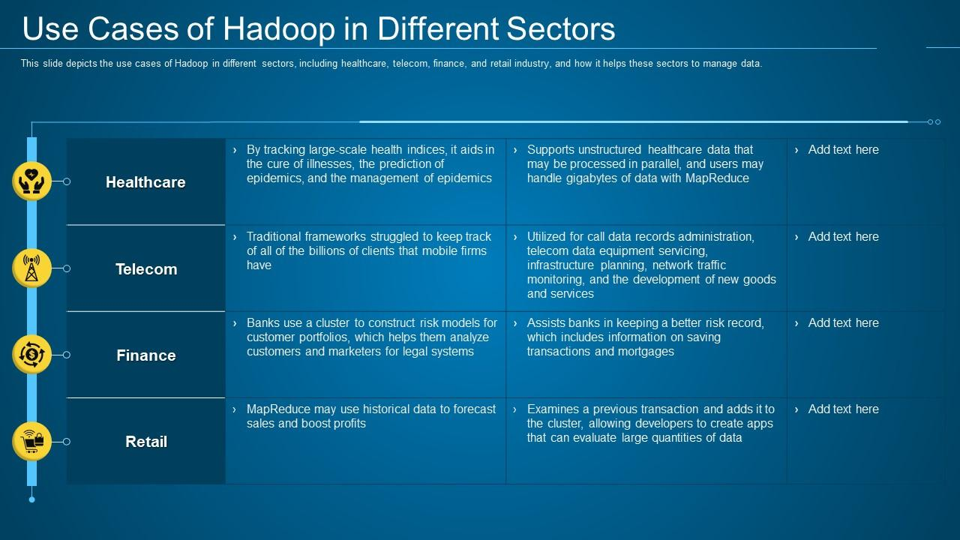

Slide 22
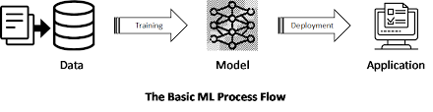
MACHINE LEARNING
An application of AI that provides systems the ability to learn on their own and improve from experiences without being programmed externally. If your computer had machine learning, it might be able to play difficult parts of a game or solve a complicated mathematical equation for you.
Example:
Google Search
Voice and Facial Recognition
VR in Gaming Word
Online Shopping
Commutation
TYPES OF ML:
Supervised machine learning: To supervise the machine while training it to work on its own. This requires labeled training data
Unsupervised learning: There is training data, but it won’t be labeled
Reinforcement learning: The system learns on its own
Notes:
Google Search
The search engine collects all of the information based on your search query and presents the results that are most relevant. Without Google, the task would be tedious
Voice and Facial Recognition
Machine learning has made it possible and now many are using this feature for their benefit.
For instance, Facebook automatically recognizes the people in a photo and tags them for you, saving a lot of time.
Without machine learning, Siri, Cortana, or Iris would not be able to answer our questions.
Virtual Reality in the World of Gaming :
PS4 and Xbox have introduced virtual reality glasses that bring a whole new level of detail into gaming. Every time your head moves in the real world, it replicates the movement in the virtual world, providing an excellent gaming experience.
Machine learning also plays a role in gesture control, and tracks body movement and makes a corresponding movement in the game.
Online Shopping - Product suggestions
If you buy a formal shirt, Amazon suggests formal shoes, ties, blazers, and apparel that go with what you buy. Machine learning is what powers that recommendation system.
Machine learning also plays a role in customer segmentation, a crucial aspect of business success for all e-commerce platforms. Machine learning helps e-commerce platforms differentiate between customers based on what they buy, how frequently they buy, and their reviews. This helps companies ensure that their customers are taken care of and that their needs are being fulfilled.
Commuting (Uber):
Suggesting drop-off and pick-up points: Once you have traveled with Uber, you’ll see that the app suggests other places you might want to go, based on your previous journeys.
Uber Share: When you're taking a shared ride, the app makes sure that the car you get is shared with customers traveling the same route you take during your commute. The app uses machine learning to sort through various factors, such as distance, traffic, and ratings before vehicle allocation.

Slide 23
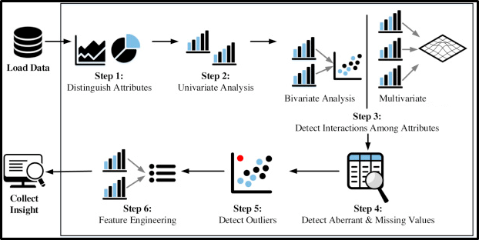
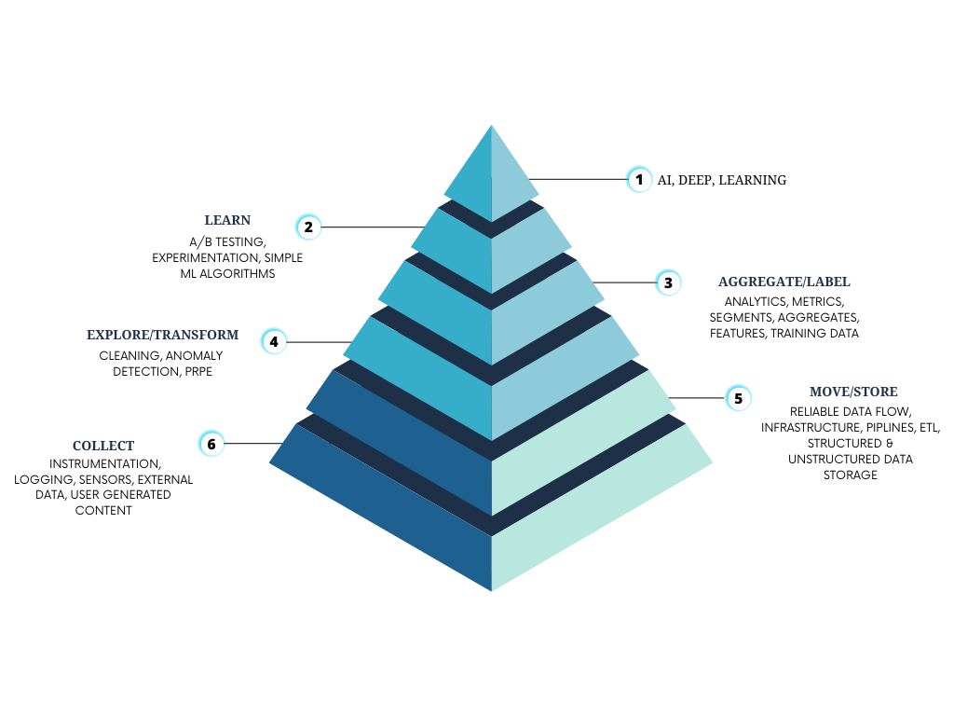
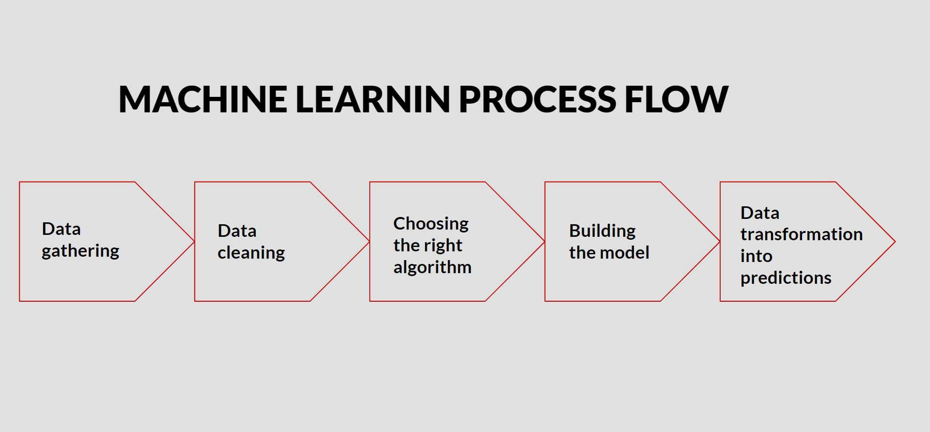

Slide 24
